Slide 1

PASSPORT AUTOMATION SYSTEM
Month
SEPTEMBER 2021

Slide 2

GROUP MEMBERS
DHEERAJ PRAKASH . S
MICHEAL JONES . J
DEEPAKUMAR . G
ABILASH .S

Slide 3
SRS DOCUMENT

Slide 4
UML DIAGRAMS

Slide 5
USECASE TEMPLATE
Name – PASSPORT AUTOMATION SYSTEM (PAS)
Primary Actor – Applicant, Police
Goal in Context – To Issue Passport for the applicant after verifying the details provided in an online mode to make the
work faster.
Preconditions – PAS system has to be programmed and as to register an applicant for the passport verification.
Scenario – 1. Applicant observers the PAS Dashboard
2. Applicant Register himself for availing a passport
3. Applicant enters the personal details and submit valid document
4. Applicant receives acknowledgment about his status.
5. Police will update the details about the Applicant as per their records
Triggers – On Completion of every activity a the database should be updated properly
Extensions points - -
Exceptions – 1. The PAS Dashboard is not ready
2. Invalid Documents are uploaded
3. Existing criminal case on Applicant
4. Administrator’s Dashboard is not working
5. Total number of allowed submission after rejection
Priority – Essential and must be implemented in Passport Automation System
Secondary Actor – Administrator, Regional Administrator
Open Issues - – 1. Is there a need to display any additional Information by the Dashboard?
2. For how many times the Applicant can apply after rejection?
3. How much time is allowed to the Administrator to update Applicant about the process?

Slide 6
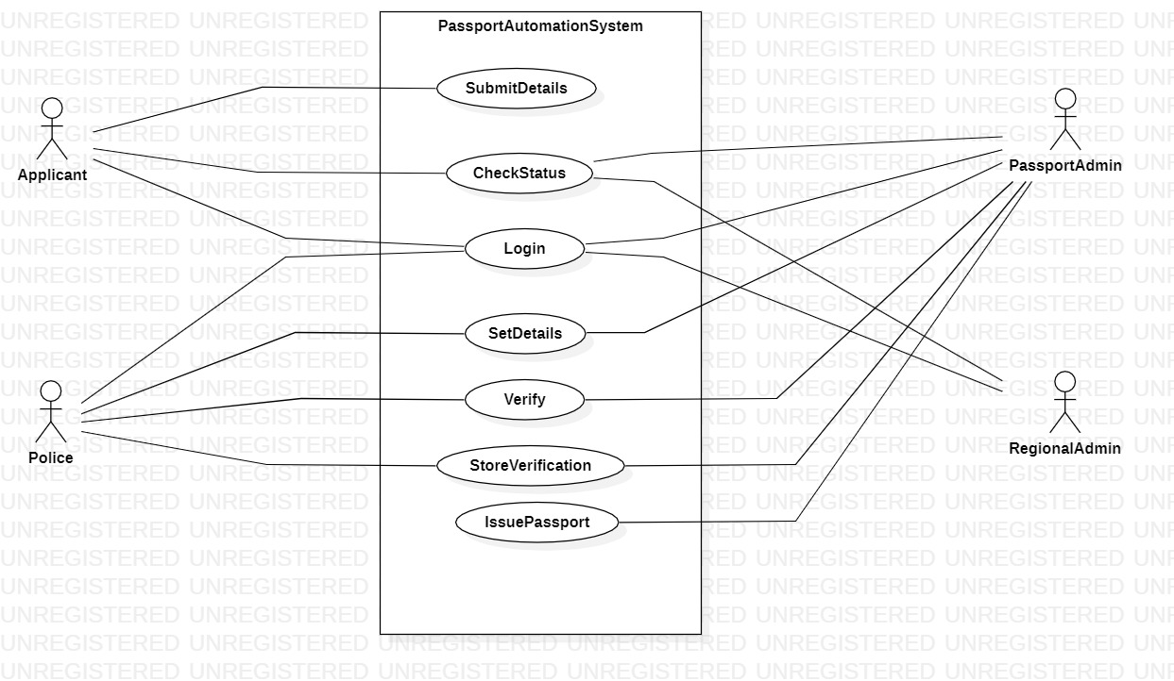
USECASE DIAGRAM

Slide 7
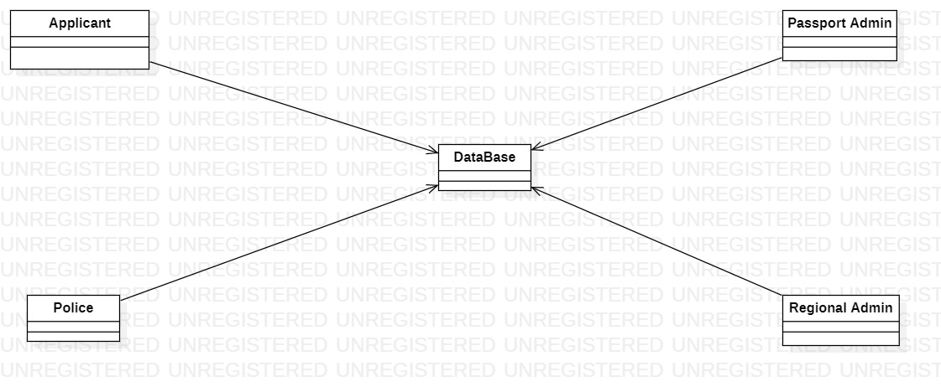
BASIC DOMAIN MODEL

Slide 8
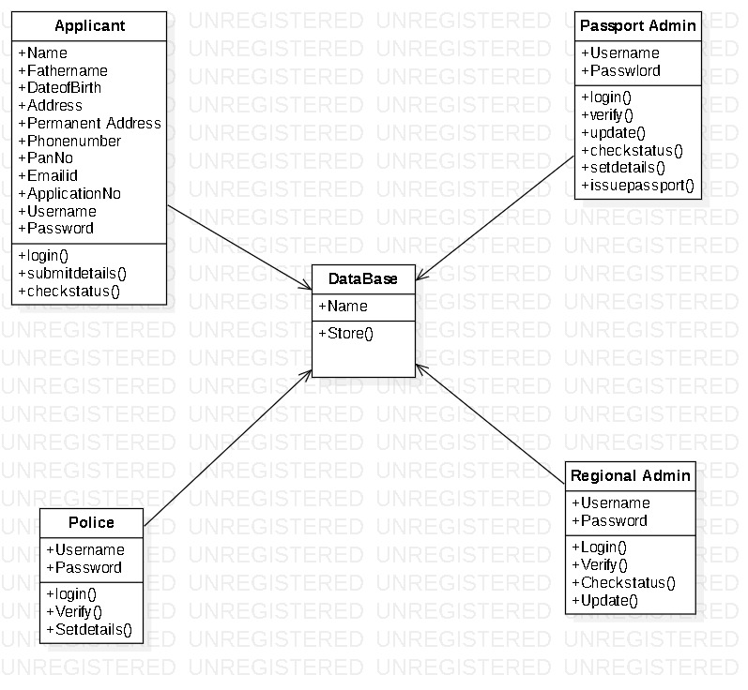
CLASS DIAGRAM

Slide 9
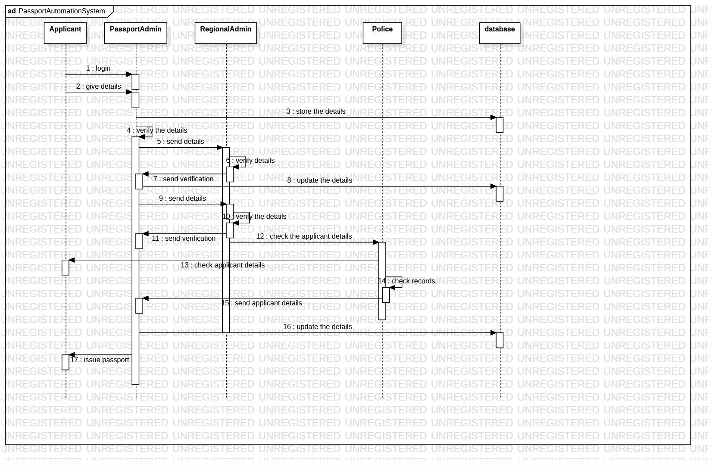
SEQUENCE DIAGRAM

Slide 10
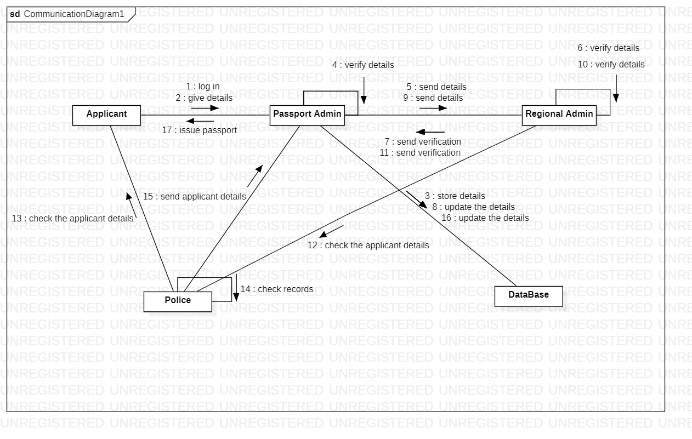
COLLABORATION DIAGRAM

Slide 11

THANK YOU!
BY:
DHEERAJ PRAKASH . S
MICHEAL JONES . J
DEEPAKUMAR . G
ABILASH .S

